Slide 1
Blood Bank and Donation Management System

Slide 2
TABLE OF CONTENTS
01
02
03
04
Introduction
Software Design
User get all the gifs regarding trending, entertainment, reactions and many more.
A use case diagram is a dynamic or behavior diagram in UML.
Testing
Implementation
Tanslating design specification into source code.
Full-Fledged responsive website all gifs with searching option.

Slide 3
INTRODUCTION

Slide 4

OVERVIEW
The Blood Bank and Donation Management System is a website that stores, processes, retrieves, and analyses data about blood bank administration. It also supervises blood inventory management and other blood bank-related activities. The major goal of the blood bank management system is to keep track of blood, donors, blood groups, blood banks, and stock information.

Slide 5
MOTIVATION
The Blood Bank and Donation Management System Project must answer or address the needs of every issue that happens in the blood bank. The issues could include difficulty in tracing their donors, managing blood bank accounts, and addressing the efficiency of doing transactions in Hospitals.

Slide 6
PROJECT PLAN
Objective : The Blood Bank Management System (BBMS) is an application that stores, processes, retrieves, and analyzes data about blood bank administration. It also supervises blood inventory management and other blood bank-related activities.
Scope : The major goal of the blood bank management system is to keep track of blood, donors, blood groups, blood banks, and stock information.

Slide 7
SOFTWARE DEVELOPMENT LIFE CYCLE
REQUIREMENT ANALYSIS
Stage 1
Stage 2
SOFTWARE DESIGN
SYSTEM TESTING
Stage 3
Stage 4
IMPLEMENTATION
PROJECT DEPLOYMENT
Stage 5

Slide 8
01
Software Requirements

Slide 9



SOFTWARE REQUIREMTS
35%
50%
HTML
CSS
Structure of the webpage
Complete design of the webpage
15%
JAVASCRIPT
Created netword-centric application

Slide 10
02
Software Design

Slide 11
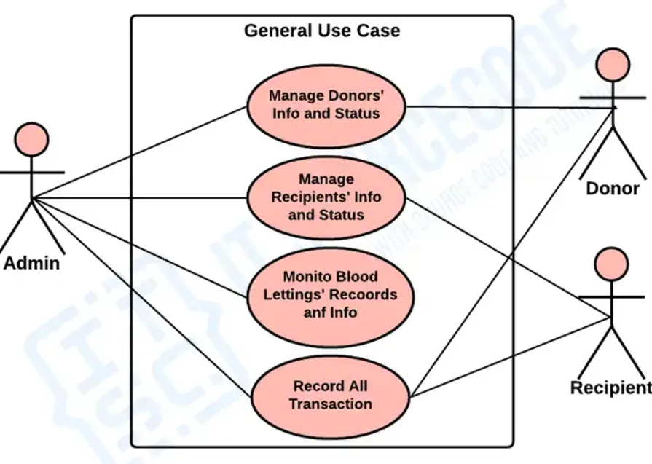
Use Case Diagram:
Used simple mapping of data images in Grid view. Having a navbar at top, a search bar below it and a Home Page as its landing page.

Slide 12
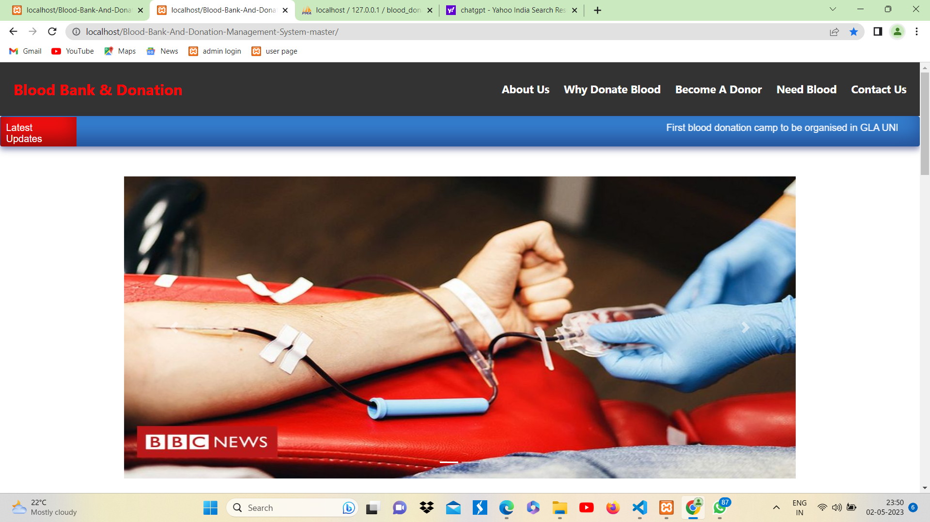
Overlay:
Used simple mapping of data images in Grid view. Having a navbar at top, a search bar below it and a Home Page as its landing page.

Slide 13
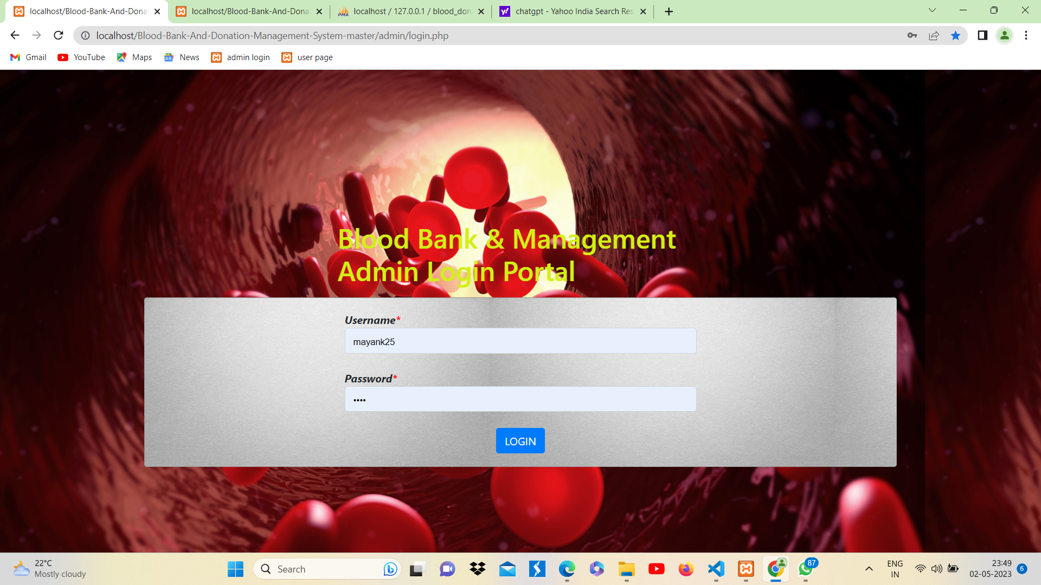
Admin Login:
A login page for admin by which he/she can access the admin panel and see all the data base and other activities of user.

Slide 14
03
System Testing

Slide 15
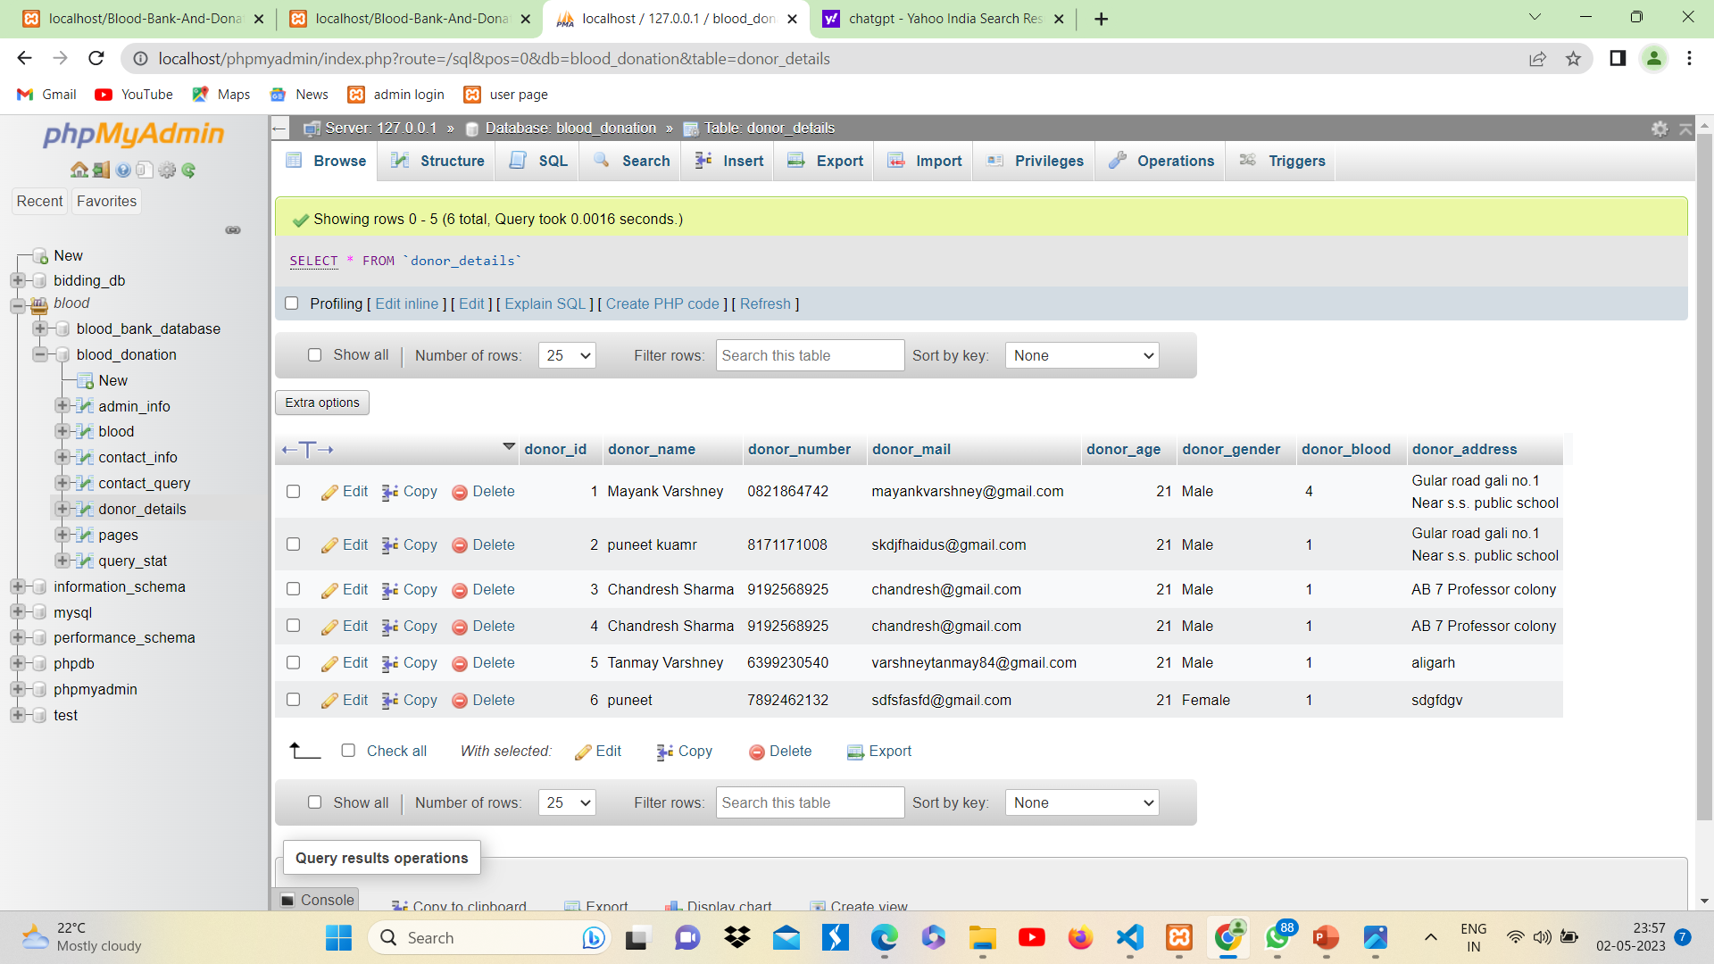
Database of user for Blood Donation :
Data is fetching successfully.

Slide 16
04
Implementation

Slide 17
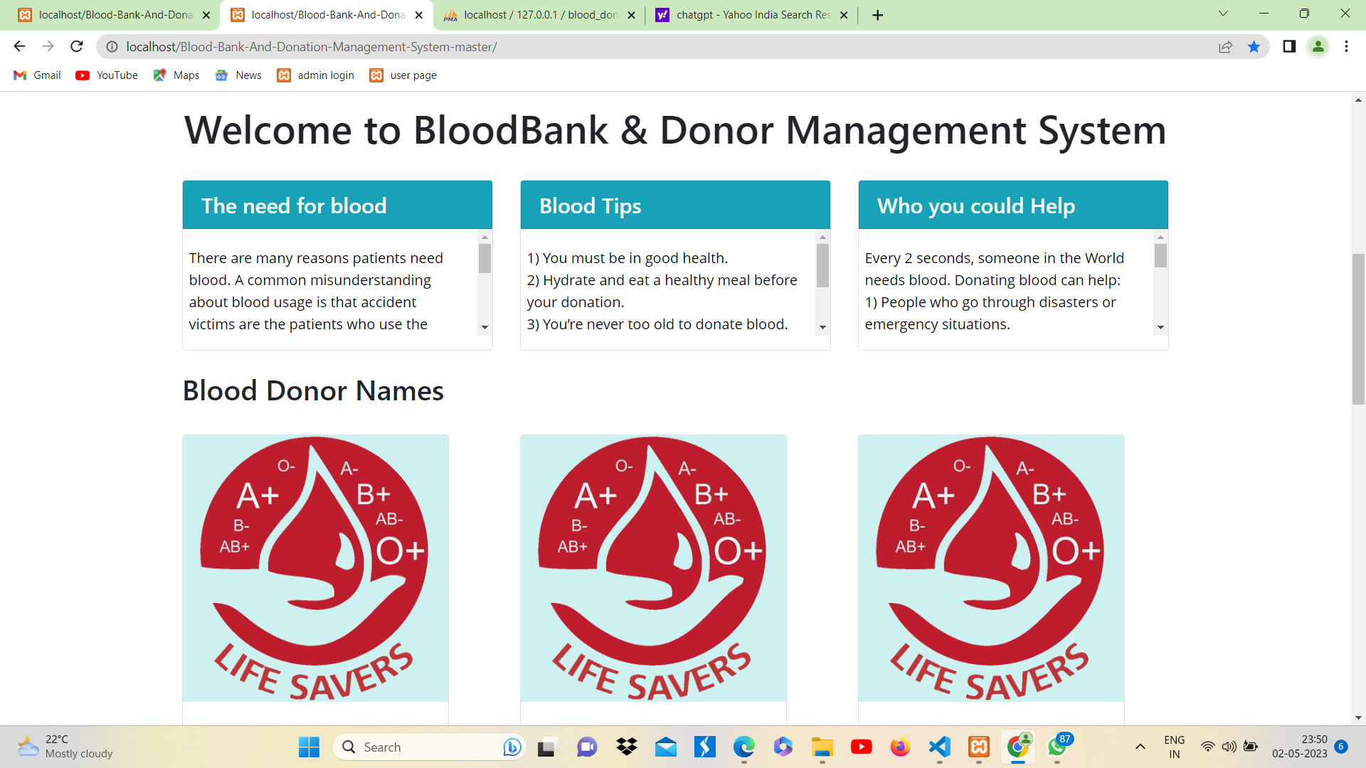
Implementation:
The website is finally implemented using HTML, CSS, and JS.
We used some pre saved Images for faster response.

Slide 18
05
Deployment

Slide 19
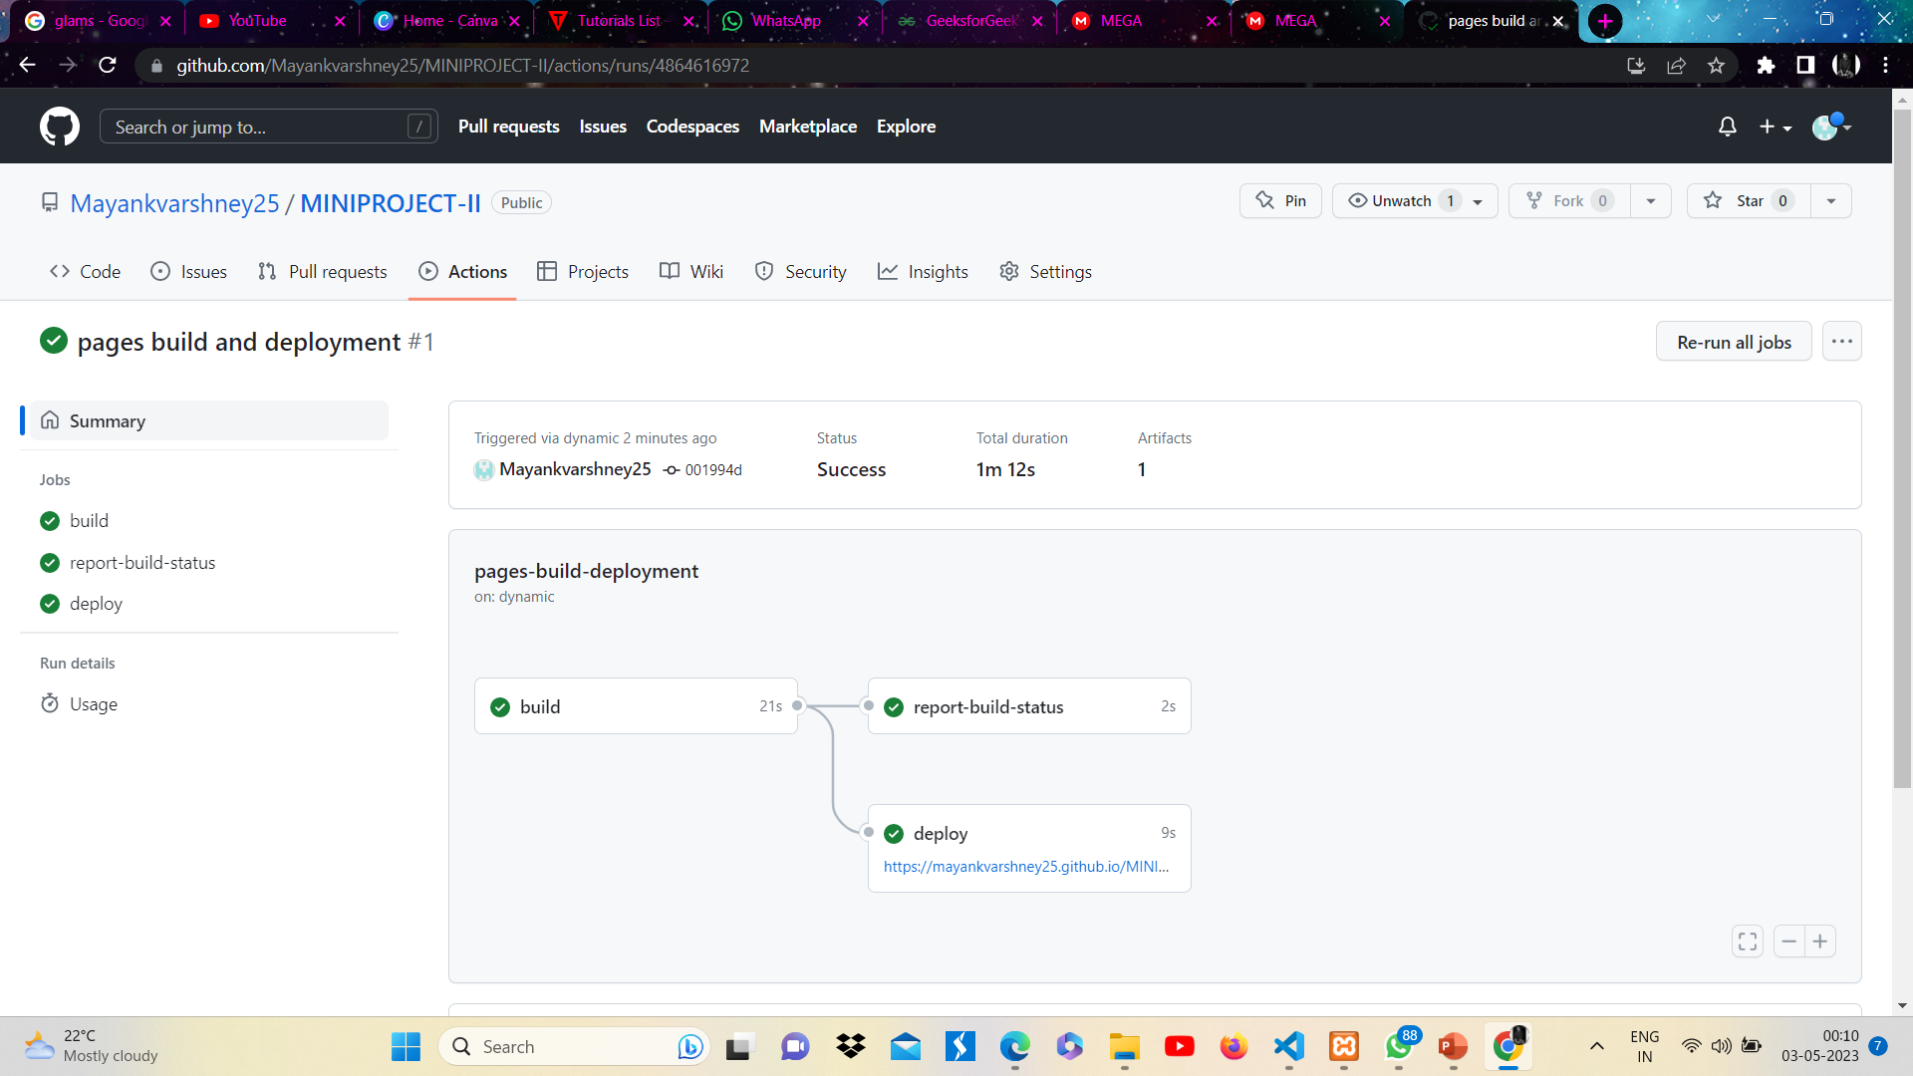
Deployment:
The project was finally deployed successfully on GitHub Pages and is ready to use in real life.

Slide 20
THANKS!

